Slide 1

Build & Control a rolling robot Wonchul Kim & Chan Sagong School of Electrical & Elentronic Engineering, Yonsei University, Seoul, Korea
Notes:
This is what we’ve done during this semester, build & control a rolling robot

Slide 2
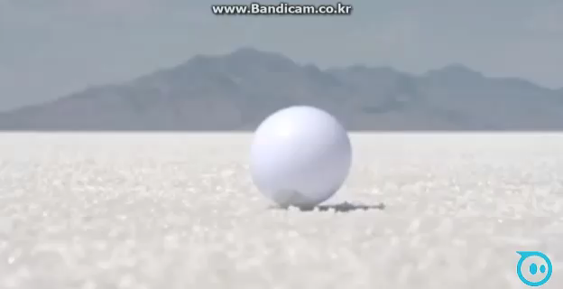
What is a rolling robot?
Notes:
To start with this, I want to tell about what a rolling robot is itself. Literally, it is a robot looked like a ball and rolled on the ground as you can see in the video. The first one is called a sphero which is customized for kids or adults, and the second one is a rolling robot made by someone.

Slide 3
How to build
1) Make a Hardware(frame)
Make the main frame as tight as possible.
Position the most mass on the bottom of the center
Use the friction between wheel and sphere as much as possible
Use all space of the robot thoroughly
Notes:
We’ve done many trial and error for this part. Since it was our first time to make a hardware of the robot, we had no idea : how to start and what we should do… First, we need to choose a general outline like how many motors we would use, how to balance it, how to compose the elements of it, and so on. Having gone through all those, these are what we could learn for almost 2 months.

Slide 4
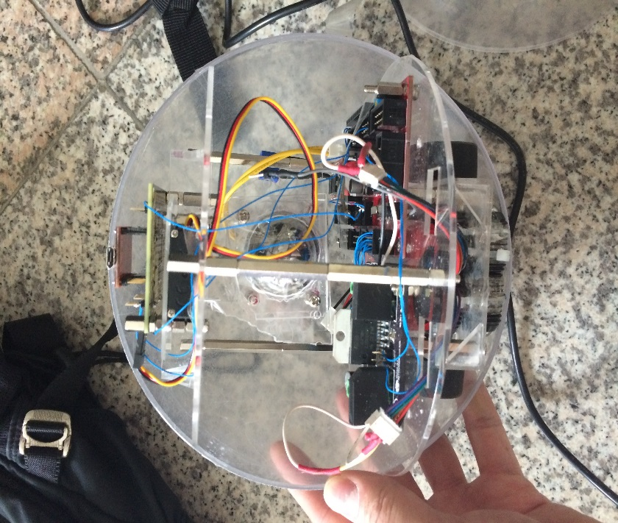
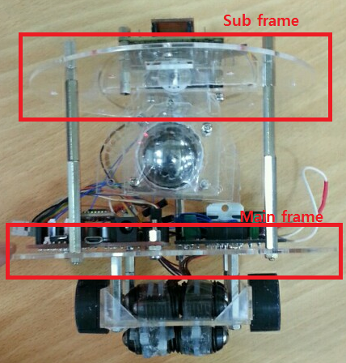
How to build – Make a hardware
Make the frames as tight as possible
Diameter
Sphere : 18cm Main : 17cm Sub : 14cm
Notes:
Assigning the size of the frames as tight as possible, it gets more stable when it moves and especially changes the velocity and direction. When it moves, the frames are also moving inside the external sphere and hits the sphere which brings the undesired force to the robot, so the robot swings and gets unstable.

Slide 5
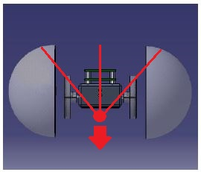
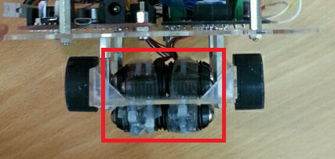
How to build – Make a hardware
Position the most mass on the bottom of the center
Attach something heavy under the wheel line
Notes:
This idea looks very simple to come up with, but the thing in this part is the exact location of the center gravity. In the first time, we had tried to position the most mass just lower hemisphere.

Slide 6
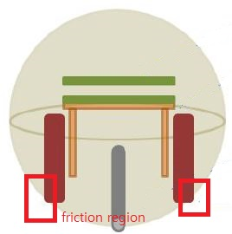
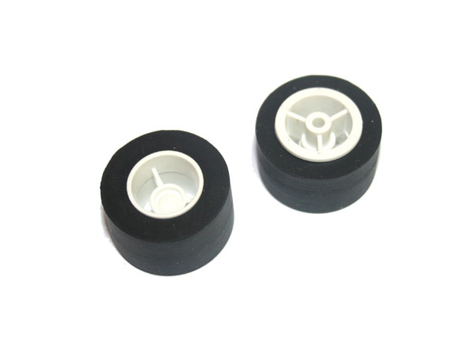
How to build – Make a hardware
Use the friction of the wheels
Notes:
When it comes to the actual part of driving part of this robot, it would be the between motors and external sphere. This small regions of them would support all the mass of a the robot and bear the torque of the motors which must be big enough to drive. So the friction of these two regions is very important, this is why we chose these wheels. Considering the strength and friction, the wider contact surface is has, the more power and friction it gets, and the material of these is rubber, so it get more friction efficiently.

Slide 7
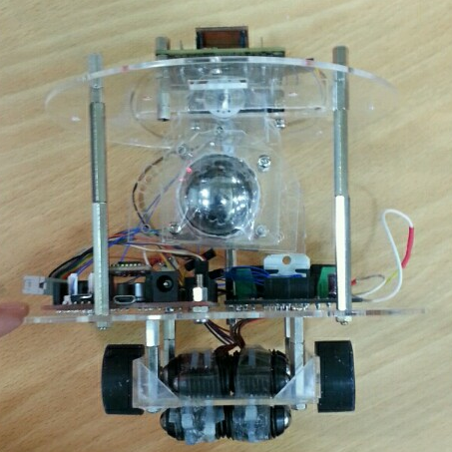

How to build – Make a hardware
Use all space of the robot thoroughly
Notes:
When it comes to the actual part of driving part of this robot, it would be the between motors and external sphere. This small regions of them would support all the mass of a the robot and bear the torque of the motors which must be big enough to drive. So the friction of these two regions is very important, this is why we chose these wheels. Considering the strength and friction, the wider contact surface is has, the more power and friction it gets, and the material of these is rubber, so it get more friction efficiently.

Slide 8
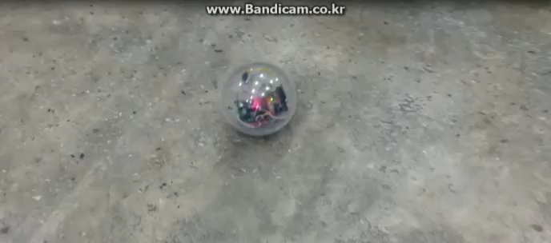
How to build
2) Acc/Dec control of DC Motors
Notes:
This is our first model before using the acceleration and deceleration control of DC motors. As you can see, whenever the robot changes the direction, the rebound of inertial force breaks its stability.

Slide 9
How to build - Acc/Dec control of DC Motor
We made 10 modes to handle several situations that could
happen while it is moving and the below shows those happenings.
When the command is like this:
Forward : stop → Forward / Forward → Forward
/ backward → Forward
Backward : stop → Backward / Forward → Backward
/ backward → Backward
Left : Forwarding → decrease only left motor
/ Backwarding → decrease only right motor
Right : Forwarding → decrease only right motor
/ Backwarding → decrease only left motor

Slide 10
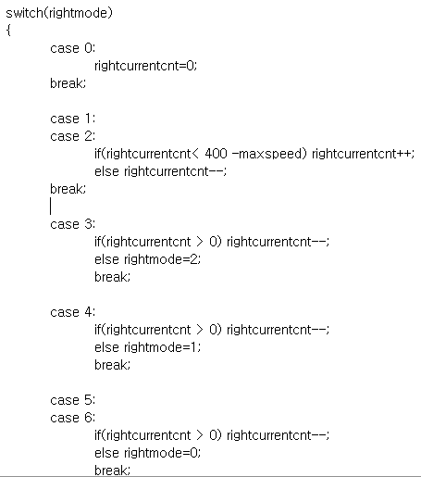
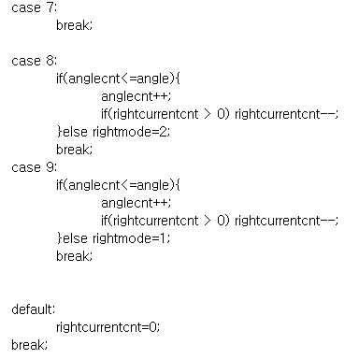
How to build - Acc/Dec control of DC Motor
Notes:
0 : 정지
1 : 2 : 천천히 증/감? 유지?
3: 천천히 감소하다 2
4: 천천히 감소하다 1
5: 6: 천천히 감소하다 정지(0)

Slide 11

How to build
Company LOGO
3) Mechanism of Cheetah’s tail
Notes:
This is the way to control the balance of right & left. The remarkable thing in this video is the movement of the cheetah’s tail. When cheetah goes to right, tail moves to left and when it goes to left, tail must move to right. So what we came up with to get a stable balance of right & left is to use the mechanism of cheetah’s tail.

Slide 12
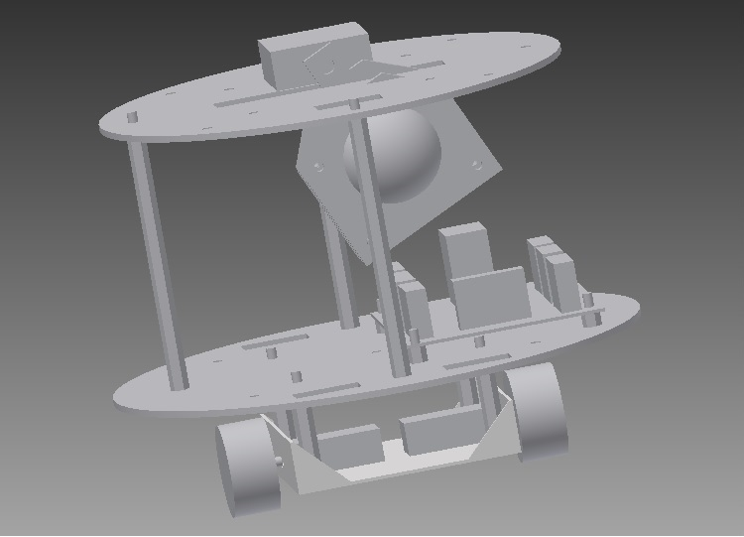
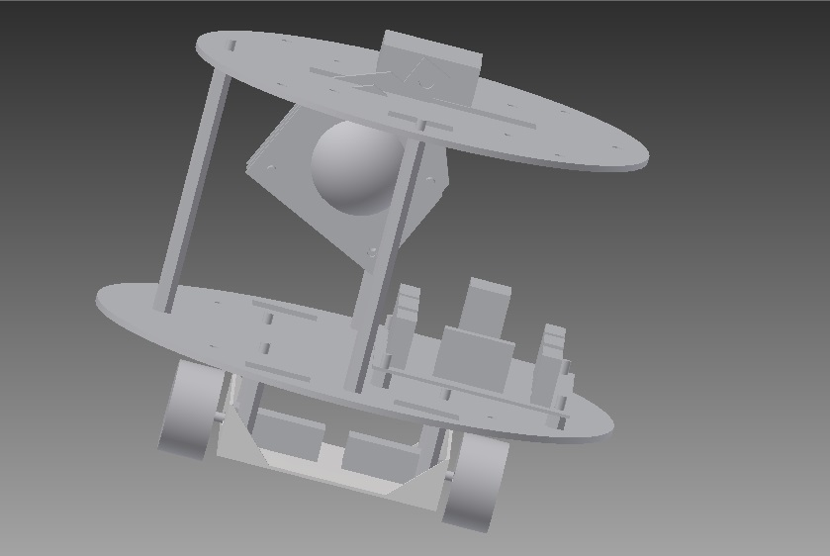
How to build
Company LOGO
3) Mechanism of Cheetah’s tail
Notes:
This is the model we made by mocking the cheetah’s tail. The small sphere with the upper frame is thing heavy enough to recover the balance, which is aligned to the servo motor. In the same fashion to the cheetah’s tail, it moves the other side of the weight balance of right & left.

Slide 13
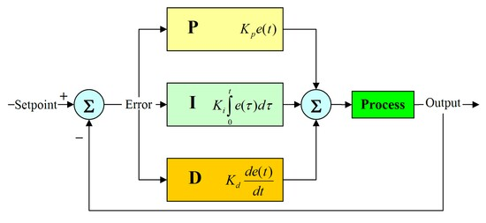
How to build - Mechanism of Cheetah’s tail
Company LOGO
PID control
P = proportional I = Integral D=Derivative
Notes:
P=proportional
Produces an output value that is proportional to the current error value. The proportional response can be adjusted by multiplying the error by a constant K_{p}
I=Integral
The sum of the instantaneous error over time and gives the accumulated offset that should have been corrected previously
D=Derivative
The derivative of the process error is calculated by determining the slope of the error over time and multiplying this rate of change by the derivative gain K_{d}

Slide 14
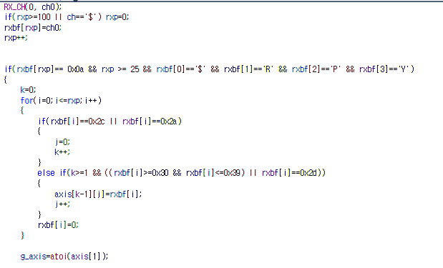
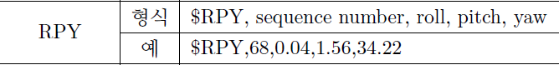
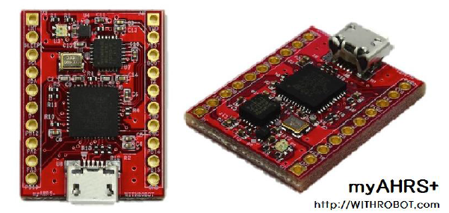
How to build - Mechanism of Cheetah’s tail
Company LOGO

Slide 15
How to build - Mechanism of Cheetah’s tail
Company LOGO
err = 0 - (((double)(g_axis/100))/500); //g_axis is current angle value
Kp = 20 * err;
I_err += err * 0.001;
Ki = 0.1 * I_err;
D_err = (err-prev_err)/0.001;
Kd = 1 * D_err;
prev_err = err;
control = Ka + Kb + Kc;
target_duty = 114 + (unsigned int)control;

Slide 16
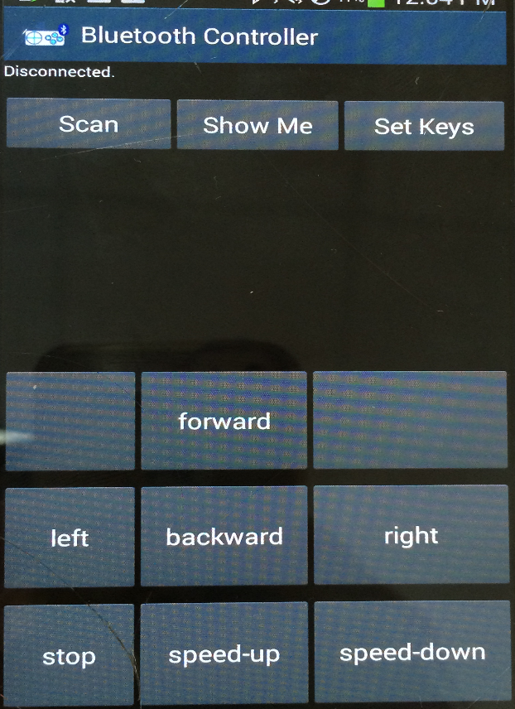
How to control
1) Bluetooth controller
This is a Bluetooth controller offered on the google store for free. What we just have done is making the path to communicate between Bluetooth module of the MCU and smartphone and setting some options like keys and variables.

Slide 17
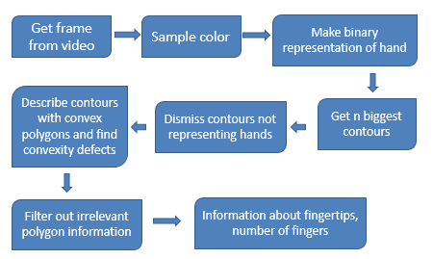
How to control
2) Number of fingers from webcam
Notes:
This flowchart shows how to track hand and count the number of fingers simply. Seeing this flowchart, it says that it begins with getting the sample colors of hand from the video, so the hand tracking is based on color recognition. With the next steps, I am going to cover one by one continuously in the next slides.

Slide 18
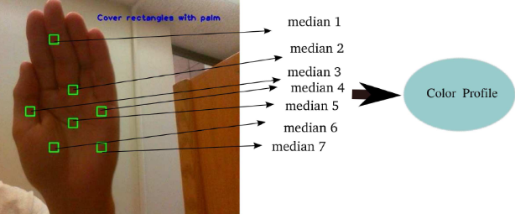
How to control
2) Number of fingers from webcam
Notes:
The hand is then extracted from the background by using a threshold using the sampled color profile. Each color in the profile produes a binary image which in turn are all summed together. A nonlinear medain filter is then applied to get a smooth and noise free binary representation of the hand.

Slide 19
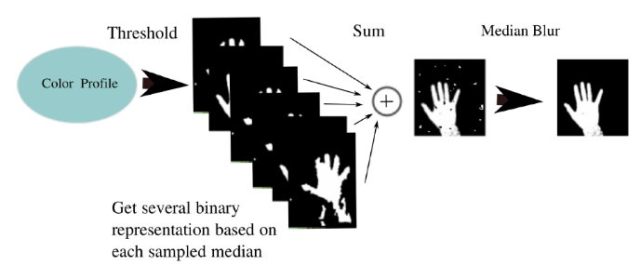
How to control
2) Number of fingers from webcam

Slide 20
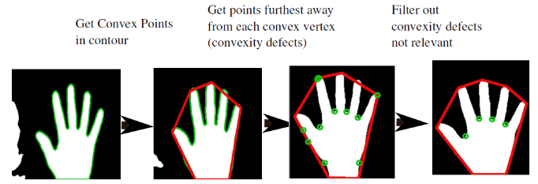
How to control
2) Number of fingers from webcam
Notes:
When the binary representation is generated the hand is processed in this following way:

Slide 21
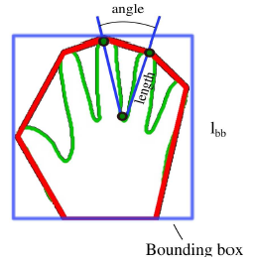
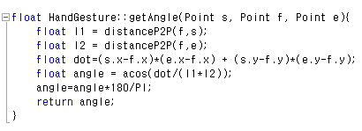
How to control
2) Number of fingers from webcam
Notes:
The properties determining whether a convexity defect is to be dismissed is the angle between the lines going from the defect to the neighboring convex polyson vertices.

Slide 22
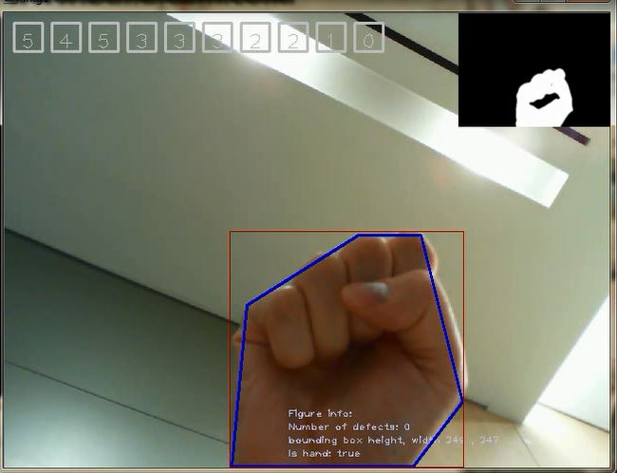
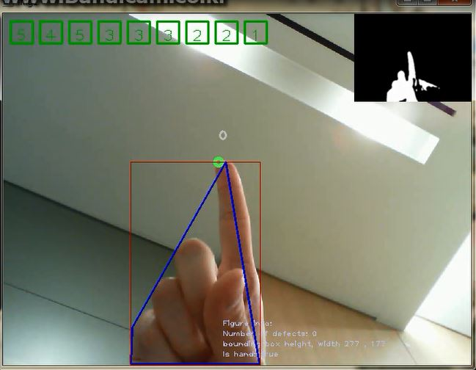
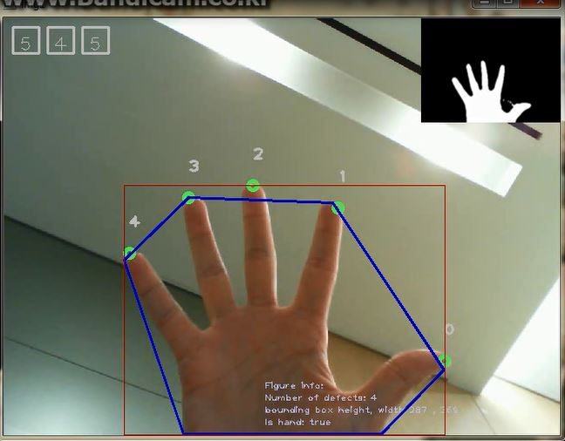
How to control
2) Number of fingers from webcam
1 : forward 2 : Backward 3 : Left 4 : Right 5: Stop
Notes:
So we assigned each command as like this: 1~ 2~

Slide 23
Let’s see the
demonstration
of our rolling robot

Slide 24
Q & A
Thanks for listening

